Slide 1
Sino-Japan Trade Report
May 2025
Released on June 1st., 2025

Slide 2
Outline
1. Summary
1.1 Global Economy and Merchandise Trade
1.2 China’s Macro Economy
1.3 Japan’s Macro Economy
1.4 Sino-Japan Merchandise Trade
2. Appendix I
2.1 GDP
2.2 PMI

Slide 3
1. Summary
1.1 Global Economy and Merchandise Trade
The J.P.Morgan Global Manufacturing PMI fell to 49.8 in April, down from 50.3 in March, and deteriorated for the first time in four months. Although the rate of decline was only marginal, the survey data provided evidence of further potential weakness. Global trade conditions worsened while jobs were cut. Business optimism slumped to two and a half years lowest and employment fell for ninth consecutive month. India, Ireland and the Philippines saw the greatest increases in production during April. Expansions were also registered in China and the euro area (among others). The US and Japan were two of the larger nations to see contractions.
J.P.Morgan Global Manufacturing PMI™ Index Summary |  |  |  |  |  |  |  | Manufacturing PMI
Index |  | Mar-25 | Apr-25 | Interpretation |  |  |  | Country | Mar-25 | Apr-25
PMI |  | 50.3 | 49.8 | Deterioration, from improvement |  |  |  | Japan | 48.4 | 48.7
Output |  | 50.5 | 50.5 | Growth, faster rate |  |  |  | Korea | 49.1 | 47.5
New Orders |  | 50.8 | 49.8 | Decline, from increasing |  |  |  | India | 58.1 | 58.2
New Export Orders |  | 50.1 | 47.2 | Decline, from increasing |  |  |  | Vietnam | 50.5 | 45.6
Future Output |  | 60.9 | 57.2 | Growth expected, weaker sentiment |  |  |  | Indonesia | 52.4 | 46.7
Employment |  | 49.7 | 49.1 | Decline, faster rate |  |  |  | Malaysia | 48.8 | 48.6
Input Prices |  | 55.2 | 55.1 | Inflation, same rate |  |  |  | Thailand | 49.9 | 49.5
Output Prices |  | 52.3 | 52.6 | inflation, faster rate |  |  |  | ASEAN | 50.8 | 48.7
Remark: sa, 50 = no change over previous month, *50 = no change over next 12 months |  |  |  |  |  |  |  | United States | 50.2 | 50.2
 |  |  |  |  |  |  |  | Eurozone | 48.6 | 49.0
Data Source from S&P Global.

Slide 4
1. Summary
The latest OECD GDP Growth released on May 22nd Indicated that GDP in the OECD rose by just 0.1% in the first quarter of 2025, significantly down from an 0.5% rise in the previous quarter, according to provisional estimates. This figure represents a departure from the higher and relatively stable growth rates recorded in the OECD area over the past two years.
The overall GDP growth rate also slowed for the G7 in Q1 2025, from 0.4% to 0.1%, reflecting a mixed picture among G7 countries. GDP contracted in Japan and the United States, from 0.6% in both countries to -0.2% and -0.1%, respectively.
Asian Development Outlook April 2025 pointed out that developing Asia’s forecasts, finalized before the new US tariffs announced on 2 April, projected growth moderating to 4.9% in 2025 and 4.7% in 2026, on higher US tariffs and trade uncertainty. Stronger growth in South Asia, supported by robust domestic demand, will partly offset a slowdown in the PRC due to a still weak property sector and higher US tariffs.
Full implementation of new US tariffs and US policy uncertainty pose risks. Analysis in this report indicates that full implementation of the additional US duties announced on 2 April
would reduce growth in the PRC and other regional economies, as well as the US. Retaliatory measures by US trading partners would worsen the effects.
Additionally, the size and speed of policy changes under the new US administration remain highly uncertain, both on trade and other areas. It could reduce investment globally and in

Slide 5
1. Summary
the region, while rising trade tensions and fragmentation would boost trade costs and disrupt global supply chains.
Meanwhile, more restrictive immigration measures and more expansionary fiscal policy in the US than assumed in our baseline could stoke inflation, keeping US interest rates higher for longer than currently envisaged.
GDP Growth Rate and Inflation, % per year
 | GDP Growth |  |  |  | Inflation
 | 2023 | 2024 | 2025 | 2026 | 2023 | 2024 | 2025 | 2026
Developing Asia | 5.5 | 5.0 | 4.9 | 4.7 | 3.3 | 2.6 | 2.3 | 2.2
East Asia | 4.8 | 4.7 | 4.4 | 4.0 | 0.6 | 0.5 | 0.6 | 0.9
P. R. of China | 5.4 | 5.0 | 4.7 | 4.3 | 0.2 | 0.2 | 0.4 | 0.7
Republic of Korea | 1.4 | 2.0 | 1.5 | 1.9 | 3.6 | 2.3 | 1.9 | 1.9
South Asia | 7.8 | 5.8 | 6.0 | 6.2 | 7.9 | 6.6 | 4.9 | 4.5
India | 9.2 | 6.4 | 6.7 | 6.8 | 5.4 | 4.7 | 4.3 | 4.0
Pakistan | -0.2 | 2.5 | 2.5 | 3.0 | 29.2 | 23.4 | 6.0 | 5.8
Southeast Asia | 4.1 | 4.8 | 4.7 | 4.7 | 4.2 | 3.0 | 3.0 | 2.8
Indonesia | 5.0 | 5.0 | 5.0 | 5.1 | 3.7 | 2.3 | 2.0 | 2
Malaysia | 3.6 | 5.1 | 4.9 | 4.8 | 2.5 | 1.8 | 2.5 | 2.5
Philippines | 5.5 | 5.6 | 6.1 | 6.1 | 6.0 | 3.2 | 3.0 | 3
Singapore | 1.8 | 4.4 | 2.6 | 2.9 | 1.2 | 0.4 | 1.0 | 1.1
Thailand | 2.0 | 2.5 | 2.8 | 2.9 | 1.2 | 0.4 | 1.0 | 1.1
Viet Nam | 5.1 | 7.1 | 6.6 | 6.5 | 3.3 | 3.6 | 4.6 | 4.2
Data Source: Asian Development Outlook April 2025

Slide 6
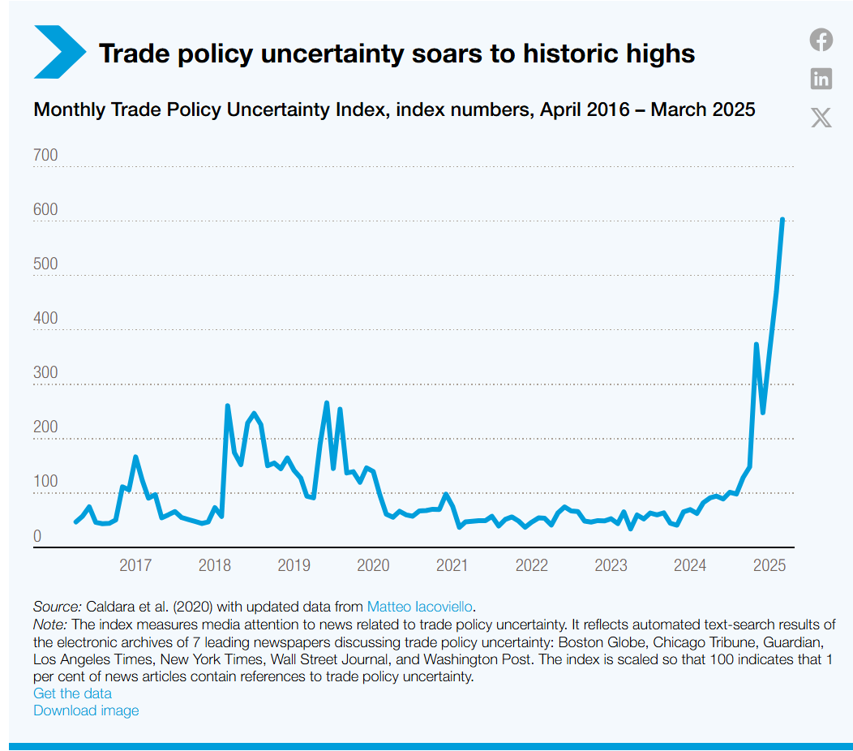
1. Summary
The news released from UNCTAD recently indicated that the world economy was on a recessionary trajectory and was expected to slow to 2.3% in 2025, driven by escalating trade tensions and persistent uncertainty.
Rising trade tensions are impacting
global trade, and disrupting supply
chains and undermining predictab
-ility. “Trade policy uncertainty is at
a historical high,” the report notes,
“and this is already translating into
delayed investment decisions and
reduced hiring.”
UNCTAD points to the growth of
Trade among developing countries,
already accounting for about one
third of global trade. “the potential
of South-South economic integration
offers opportunities for many deve
-loping countries”, the report notes.

Slide 7
1. Summary
1.2 China’s Macro Economy
In China, the PMI in May rose to 49.5%, 0.5 percentage point higher than the same in April. The Production Index and the New Order Index increased 0.9 and 0.6 percentage point m-o-m though both are still in the contraction range. The New Export Order Index jumped 3.2 percentage points m-o-m to 47.9% while Import Index became 47.1%, 3.7 percentage points higher m-o-m.
The major commodities import volume continuously dropped except copper concentrate, pulp and machine tools, indicating the spot demand is shrinking. However, the domestic and export sales of excavator and loader still increased, especially domestic sales volume went upward sharply, indicating the investment is improving.
In May, the China steel industry PMI was 46.4, a decrease of 4.2 points m-o-m which ended upward trend in the last three consecutive months and dropped into contraction range once again. Both uncertain global trade environment and weak domestic demand quite influenced steel industry.
1.3 Japan’s Macro Economy
The headline AU Jibun Bank Flash Japan Manufacturing PMI was up slightly from 48.7 in April to 49.0 in May, but remained below the crucial 50.0 neutral level to signal a deteriorat

Slide 8
1. Executive Summary
-ion in business conditions for the eleventh successive month. The relative improvement in the headline index was supported by softer falls in new orders and new export business, while companies also signaled a stronger increase in employment. However, sustainable economic development cannot rely on the employment increase only without solid demand.
After slipping to the weakest in nearly five years in April, optimism regarding the year
-ahead outlook for output picked up in May, but overall sentiment remained among the lowest seen since the COVID-19 pandemic.
1.4 Sino-Japan Merchandise Trade
Regarding Sino-Japanese merchandise trade, the trade amount of April in USD announced by the Chinese Customs increased by 4.98% y-o-y while the aggregated trade amount indicated plus 0.73% which is the first positive aggregated growth rate in 2025.
The same data released in JPY by the Japanese Ministry of Finance increased by 3.59% y-o-y in April. Though the aggregated growth rate is gradually dropping, it is always positive from the beginning of 2025 and recorded 5.97% until the end of April.
In general, the trade data indicated that growth rate of China’s export to Japan increased more than the same of Japan’s export to China in April. The most increased import goods

Slide 9
1. Executive Summary
are telecom goods, petrochemical products, audio and video equipment while the most decreased export goods are semi-conductor machinery and parts as well as automobile. Meanwhile, the container freight index of Sino-Japan route in April kept stable at 980.85 points and 0.9% higher m-o-m.
However, the conventional market between China and Japan was still quite now. In April, 105,965 tons of steel were exported from China to Japan, with a cumulative 404,833 tons in the first four months, an increase of 2.61% year-on-year. In the same month, 191,034 tons of steel were exported from Japan to China, with a cumulative 777,255 tons, a year-on-year decrease of 16.7%. Total steel trade volume in terms of metric ton including eastbound and westbound decreased 10.24%, in which part of cargoes were carried by conventional vessels.
Meanwhile, the order data of April 2025 released by the Japan Machine Tool Builders’ Association showed that orders from China increased by 27.9% y-o-y, with a cumulative increase of 27.6% up to the end of April. China and the United States occupy about 67% of the overseas order. Though the growth rate of India is quite higher, the absolute order value is still one-fourth of the China’s. The machinery and equipment export to China is still the main direction in the near future.

Slide 10
2. Appendix
2.1 GDP Statistics
Indicator | 2Q 2022 | 3Q 2022 | 4Q 2022 | 1Q 2023 | 2Q 2023 | 3Q 2023 | 4Q 2023 | 1Q 2024 | 2Q 2024 | 3Q 2024 | 4Q 2024 | 1Q 2025
China GDP Growth Rate (%) | 0.8 | 4.0 | 3.0 | 4.7 | 6.5 | 5.0 | 5.3 | 5.3 | 4.7 | 4.6 | 5.4 | 5.4
Data Source: National Bureau of Statistics (Growth Rate with year-on-year basis)
Indicator | 2Q 2022 | 3Q 2022 | 4Q 2022 | 1Q 2023 | 2Q 2023 | 3Q 2023 | 4Q 2023 | 1Q 2024 | 2Q 2024 | 3Q 2024 | 4Q 2024 | 1Q 2025
Japan GDP Growth Rate (%) | 1.2 | -0.4 | 0.3 | 1.2 | 0.6 | -1.0 | -0.1 | -0.4 | 0.9 | 0.2 | 0.6 | -0.2
Data Source: Cabinet Office, Government of Japan (Growth Rate with year-on-year basis, seasonally adjusted series)

Slide 11
2. Appendix
2.2 Monthly PMI
Data Source: National Bureau of Statistics, China
Data Source: S & P Global Manufacturing PMI

Slide 12
End of
Sino-Japan Trade Report
May 2025

